Slide 1
Using Y-DNA test results
What the test company results can tell you
Notes:
Front Page
The focus of this presentation is how to use the testing company software and facilities to discover as much as possible about a test-taker’s Y-DNA test results.
The principal testing company for Y-DNA testing is Family Tree DNA
https://www.familytreedna.com/

Slide 2
WHY SHOULD WE TEST Y-DNA? WHAT CAN IT TELL US?
The Y chromosome is one of the two sex chromosomes : X and Y
Women have two X chromosomes (no Y); Men have one X chromosome and one Y chromosome
Y-DNA is therefore important for investigating paternal lines
An identical Y chromosome is passed from FATHER to each of his SONs.
A man’s Y chromosome is inherited almost entirely unchanged from his father

Slide 3
Y-DNA fan chart
A man may have 512 male ancestors at 10 generations back.
Only ONE of those men passed down his Y chromosome to him.

Slide 4
If a man only has daughters he does not pass on his Y chromosome: he has ‘daughtered out’ as far as his Y chromosome is concerned.
In these examples there are no male descendants. A woman will need to ask a male relative to take the Y-DNA test.

Slide 5
What can we see in the Y-DNA Test results at familytreeDNA (ftDNA)
Family Tree DNA https://www.familytreedna.com/
I have the results of Y-DNA tests for three male relatives, two Brothers and a paternal Uncle
Grandfather AF (no test)
Father EF (no test) Uncle Cecil F
Brother Colin F Brother Robert F
Notes:
Sadly my father passed away before widespread DNA testing but Uncle Cecil kindly tested before he, too, died.

Slide 6
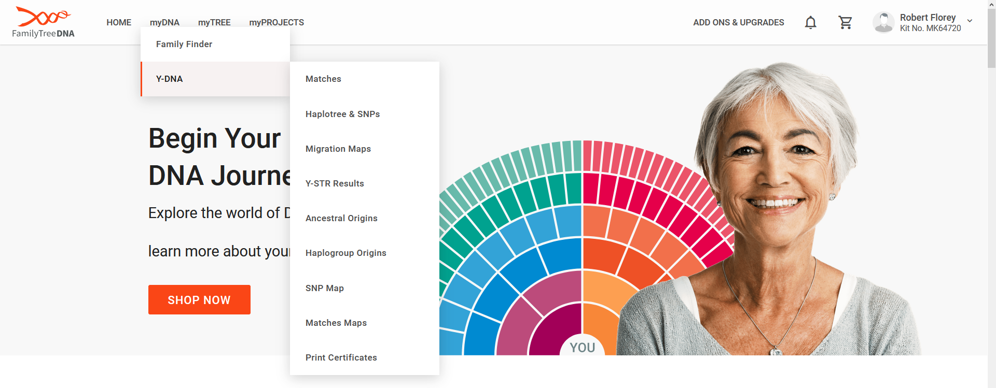
Notes:
Log on to your test results at ftDNA
www.ftDNA.com
Select Y-DNA from the myDNA menu and Matches from the Y-DNA menu

Slide 7
Why don’t you have any matches?
You may not have Matches at this Marker level (67) [try changing the Marker level to 37]
You may be the only Male in your line [can’t help you there!]
There are no Matches in the ftDNA database at this time [Encourage family members or Target males to test , or Wait]
See https://genealogy.stackexchange.com/questions/10637/is-it-common-to-have-no-close-ydna-matches-on-family-tree-dna discussion, and similar
Notes:
This is what I first saw when my Uncle’s test results came in.
No matches ‘at this level’, and that’s a clue I had requested a test at 67 Markers for Uncle so this is the default value in this screen. There are no Matches at 67 markers.
The screen may refresh to include test results for people who have tested at a lower number of Markers or you may need to amend the Markers value.

Slide 8
At 37 Markers Robert F has three Matches. Let’s look at them..
Notes:
Having changed the Markers value to 37 I can see three matches with Brother Robert. Two I can expect and one surprise!
Lets look at all the fields in this screen,

Slide 9
Filter Matches section – CHECK if the tests were conducted at different numbers of Markers. Filter at the lowest common value. 37 in this case.
Then look at the Genetic Distance values.
Notes:
Notice the Genetic Distance values 0 for the Brother and Uncle and 1 for ‘Surprise’ Robert H.

Slide 10
What if you choose an even lower number of markers?
The Genetic Distance values may change to a less helpful value.
Use the highest common value which is 37 in this case.
Notes:
Let’ just check what happens if you reduce the Markers value to ‘12’.
Now all three results show a Genetic Distance of
0 (zero).

Slide 11
 | DYS# | 393 | 390 | 19 | 391 | etc
Man A | Results | 14 | 22 | 15 | 11 | same
Man B | Results | 14 | 23 | 17 | 11 | same
What is ‘Genetic Distance’ (GD)?
GD is calculated by adding together the differences between the results for each marker, where the results differ.
In the example above there are different values at DYS 390 (a GD of 1) and DYS 19 (a GD of 2) so Man A and Man B have a total Genetic Distance of 3.
The fewer the number of differences the closer the relationship.
Nb ‘DYS’ stands for DNA Y-Chromosome Segment . 12/25/37/67/111 Segments are tested depending on which level of test was purchased.

Slide 12
As ALL men are ultimately related ftDNA only shows a test taker’s closest DNA matches.
The thresholds for ‘close’ depend on the (common) number of Markers examined for two test takers:
At 37 Markers – those Matches up to a Genetic Distance (GD) of 4
At 67 Markers – up to a GD of 7
At 111 Markers – up to a GD of 10
What does Close mean?
Notes:
So, as I am examining a group of matches at the 37 marker level they will be within a Genetic Distance of 4.

Slide 13
 | GD at 37 Mkrs | GD at 67 Mkrs | GD at 111 Mkrs
Very closely related | 0 | 0 | 0 | Closer than a ‘cousin’ so father, brother, uncle
Closely related | 1 | 1-2 | 1-2 | Very close ‘cousin’
Related | 2-3 | 3-4 | 3-5 | Likely to be in the same surname lineage
More Distantly related | 4 | 5-6 | 6-7 | Unlikely to share a common ancestor within a genealogically relevant time line
Notes:
What do the GD values mean? The meaning will vary according to the level of test i.e. at 37 or 67 or 111 markers

Slide 14
So looking at Robert’s test results:
Colin (brother) and Cecil (paternal uncle) are Very Closely Related, with a GD of 0 Zero
Robert H is Closely Related at a GD of 1
I am still investigating genealogically but I think Robert H might be descended from a ‘Half brother’ to an ancestor of mine/Colin/Robert/Cecil born in 1717. That’s about 6 or 7 generations ago.

Slide 15
What do the other symbols mean?
Email – send an email to the email account linked to the Name.
Note – for your own notes
Y-DNA 37 – test level of 37 Markers
Y DNA 67 – test level of 67 Markers
FF – the test taker also has Family Finder results
TiP – Time Predictor – see below
TiP

Slide 16
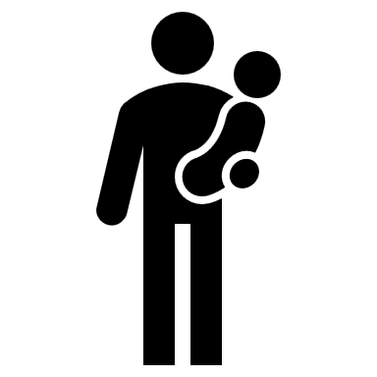
This is the Time Predictor. It is an indication of how many generations ago there was a common ancestor between the two test takers.
??
Notes:
So probably anything from 5 generations ago or further back for Robert H’s ancestor.

Slide 17
Looking at the other Match information:
YDNA Haplogroup R–M269 (aka R1b1b2 – M269). The genetic group the test taker belongs to. M-269 is the major European Y chromosome haplogroup
Terminal SNP (Single Nucleotide Polymorphism). You can buy additional SNP testing to further refine the Haplogroup.
Match Date – when the match was found by ftDNA.
Download CSV – you can download the detailed results in a CSV file

Slide 18
What else can you find in the Results?
Look at the profile data for your Matches.

Slide 19
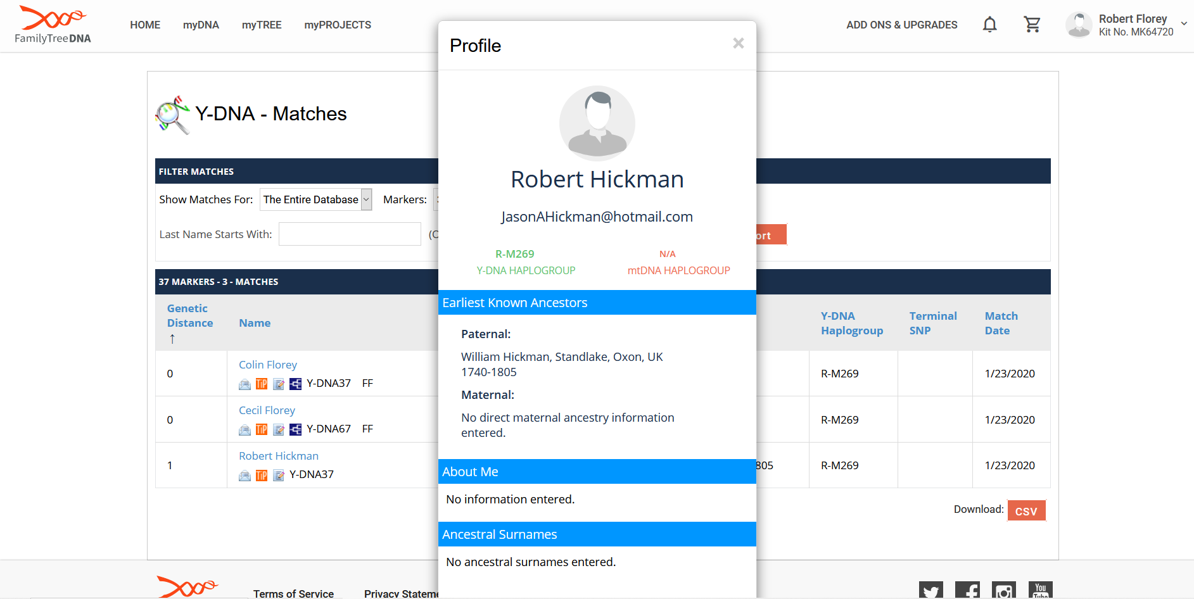
Notes:
Your Match may or may not respond to an email. Mine didn’t. I recommend you harvest all the possible info about your Match from all the test results before you contact them. They may take fright and delete/reduce access.

Slide 20
Print out a Certificate
Notes:
Your test results should be held by ftDNA for 20 years. They are in a flood/hurricane area of the USA however so probably a good idea to copy/download everything.

Slide 21
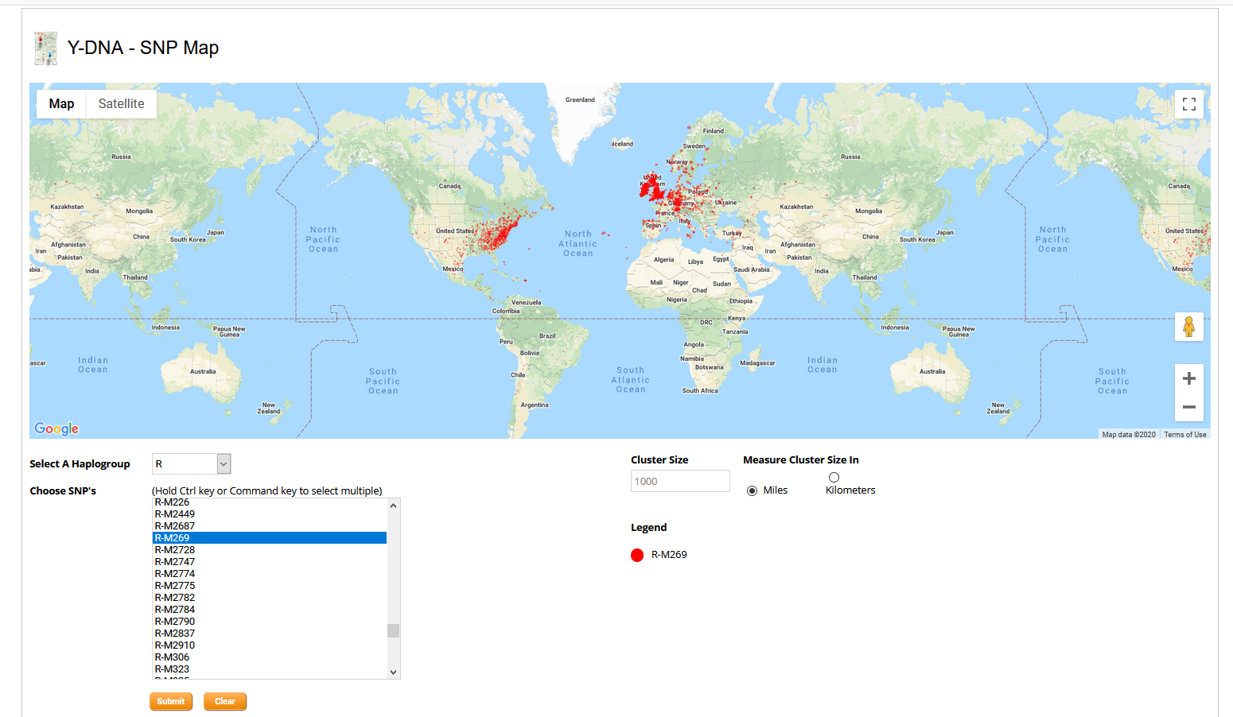
See where other people with your Haplogroup live
Notes:
This is for R-M269 so very common.

Slide 22
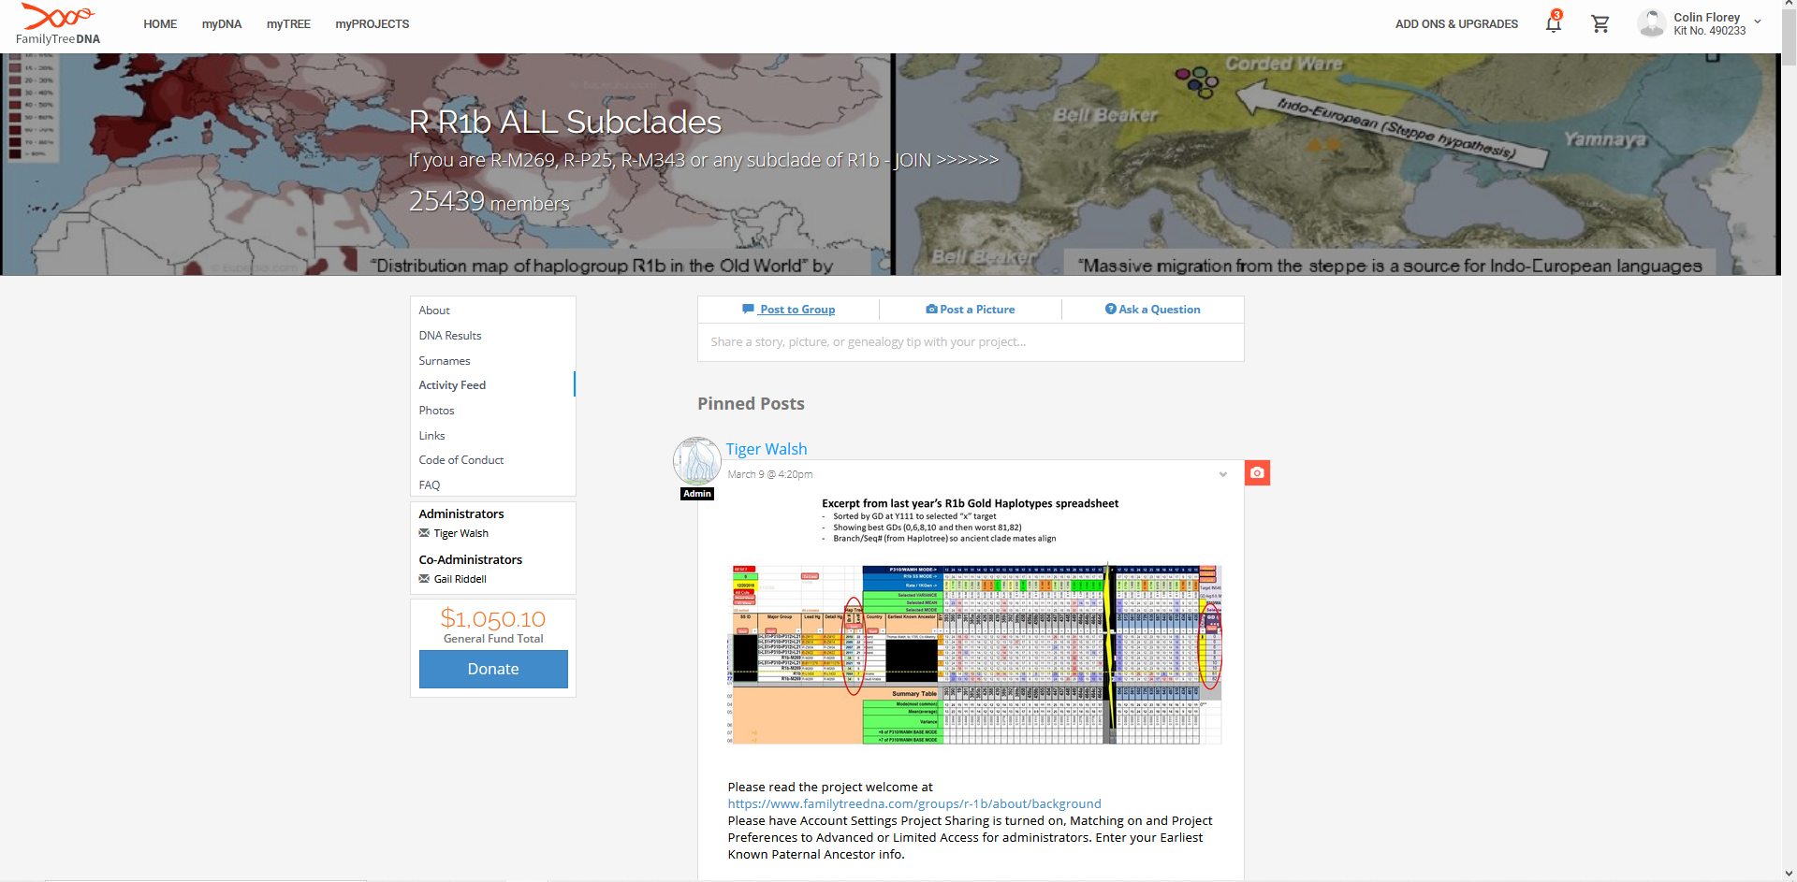
Join a SubClade group…
Notes:
Chat with other people with the same genetic interest.

Slide 23
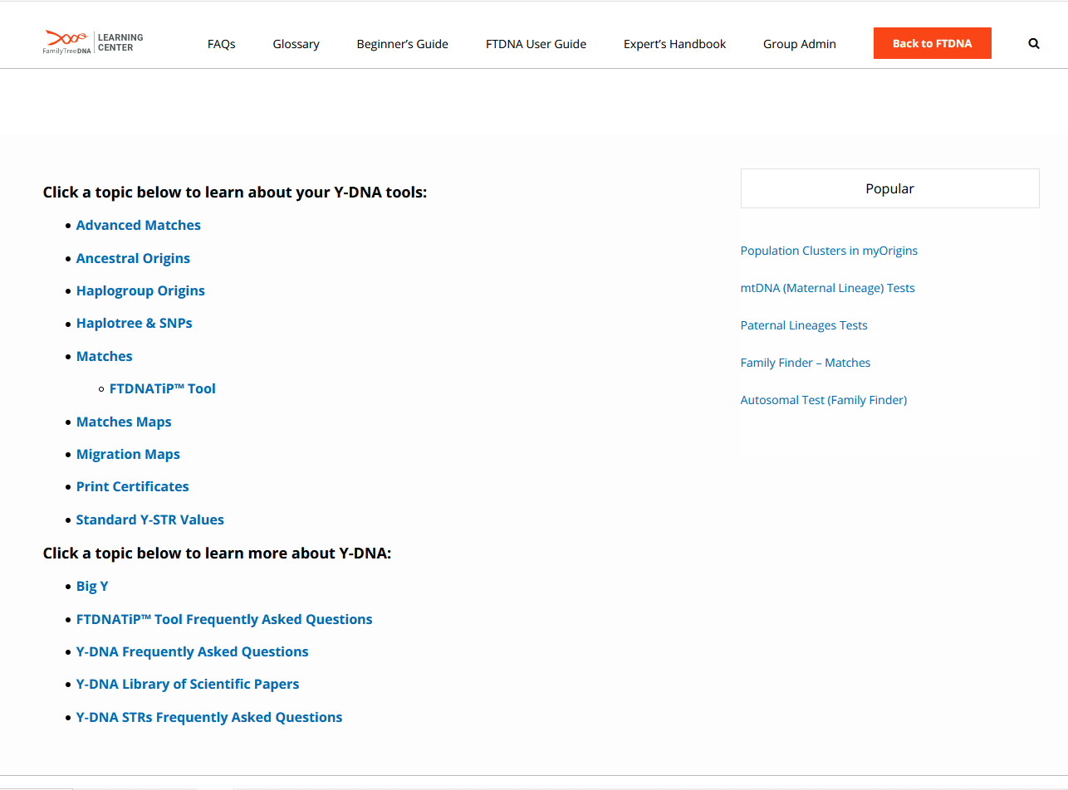
Read the Help Files
Notes:
Lots to find out!

Slide 24
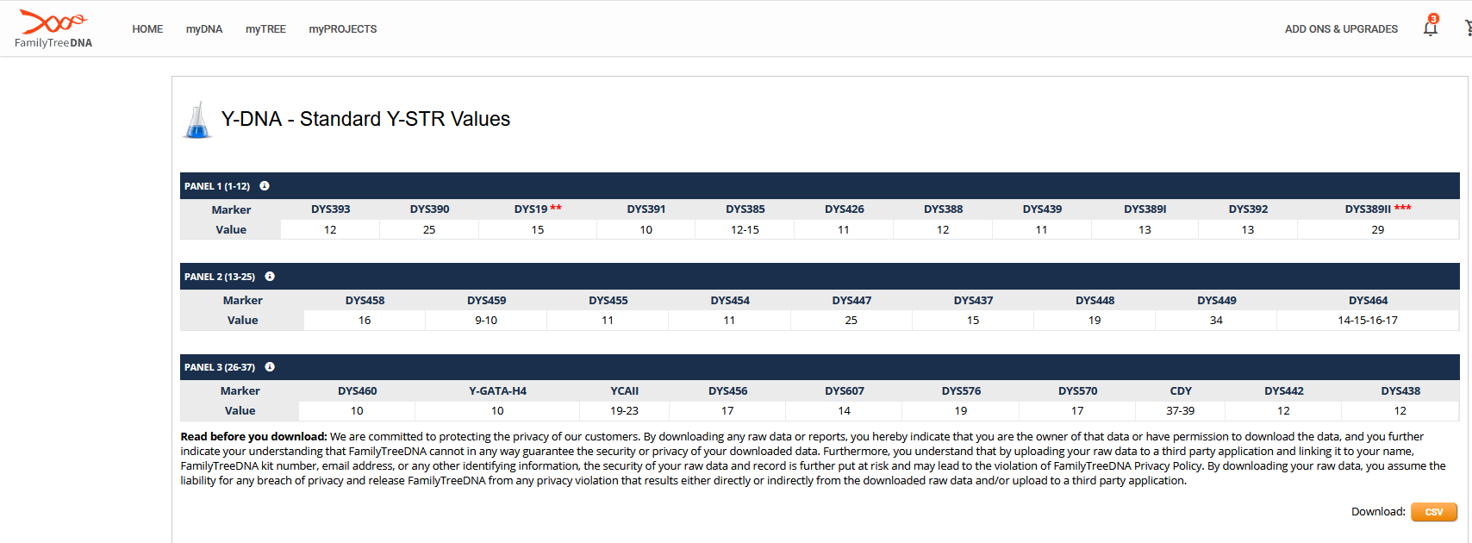
Download your detailed data …

Slide 25
Take or Upgrade your results to a BIGY-700 test. This examines 700 Y-STR (repeating groups) and multiple Y-SNP (‘snips’ which are the individual nucleotide A, T, C, and P values) along the length of the Y chromosome.
Determines a test taker’s Y-DNA haplogroup and may indicate very early ancestry
Indicates your place on the human Y-DNA tree where the progress of known mutations can illustrate where a particular test–taker either diverges from others in his haplogroup - ‘he is derived’ at that point, or his SNP result at a particular location is ‘ancestral’, meaning unchanged from the reference tree.
Your ‘terminal SNP’ is the furthest point on the Y-DNA tree to which you have been assigned.
This is an expensive test (US$ 649 for a new test, upgrades at US$ 339 for existing 37 Marker results, and US$279 for 67 Marker results) and the interpretation of the results is still evolving.

Slide 26
23and Me and LivingDNA
What you can see about Y-DNA here?
23and Me uses SNP testing to sample Y-DNA and determine a high level haplogroup for the test taker’s Y-DNA
LivingDNA does the same but uses a larger number of SNPs.
A Maternal cousin of mine ‘C’ has tested with 23and Me.
His Haplogroup result is R-Z11

Slide 27
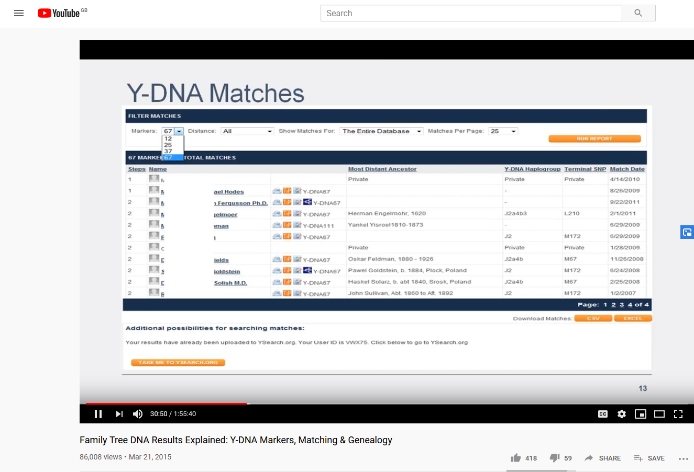
This has been an introduction only. There are further enquiries you can make on the test data in the test applications I have discussed and there is additional data and analysis you can buy.
Further reading:
Blaine Bettinger’s ‘The Family Tree Guide to DNA Testing and Genetic Genealogy’ 2nd Edition 2019 ISBN 978-1-4403-0057-8 Chapter 5 on Y-DNA testing in particular.
Check out YouTube, for example:

Slide 28
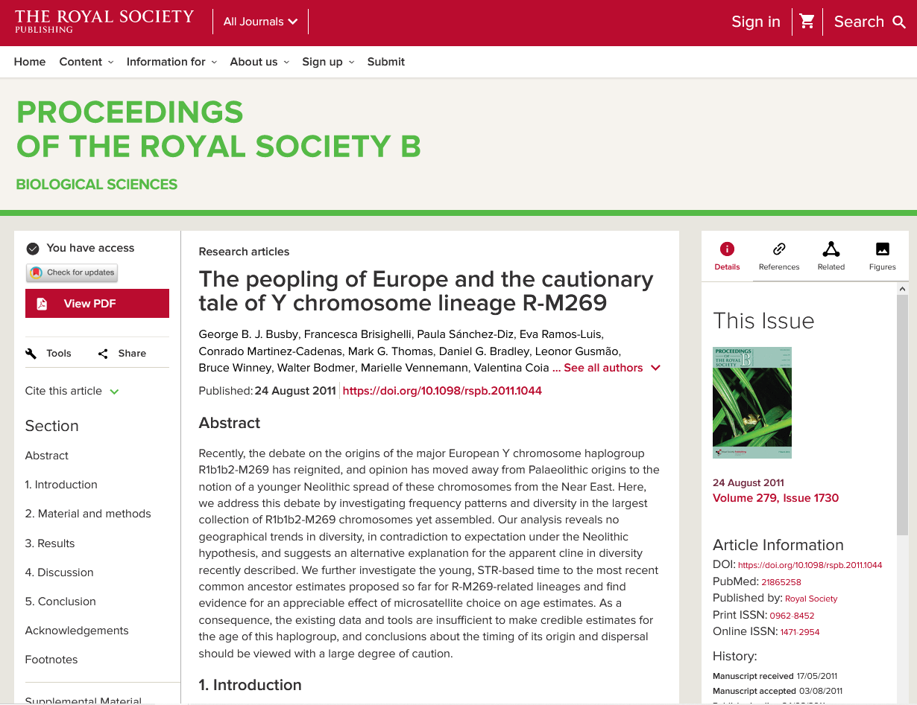
See https://royalsocietypublishing.org/doi/10.1098/rspb.2011.1044
And don’t forget this Facebook page https://www.facebook.com/groups/AncestryUKDNA/

Slide 29
Questions?

